Slide 1

: GenevaERS View Builder Training Course page 7: Column Formulas
Notes:
Welcome to the training course on , or GenevaERS. This is page 7, “Column Formulas.”

Slide 2
page Objectives
Upon completion of this page, you should be able to:
Explain the difference between column assignment and record selection
Set column attributes and assign simple constant values
Use if-then-else logic in setting column values
Create column formulas
Notes:
© Copyright IBM Corp. 2012, licensed under Apache 2.0 to the GenevaERS project .
This page provides you with an overview of GenevaERS column formulas. Upon completion of this page, you should be able to:
Explain the difference between column assignment and record selection
Set column attributes and assign simple constant values
Use if-then-else logic in setting column values
Create column formulas

Slide 3
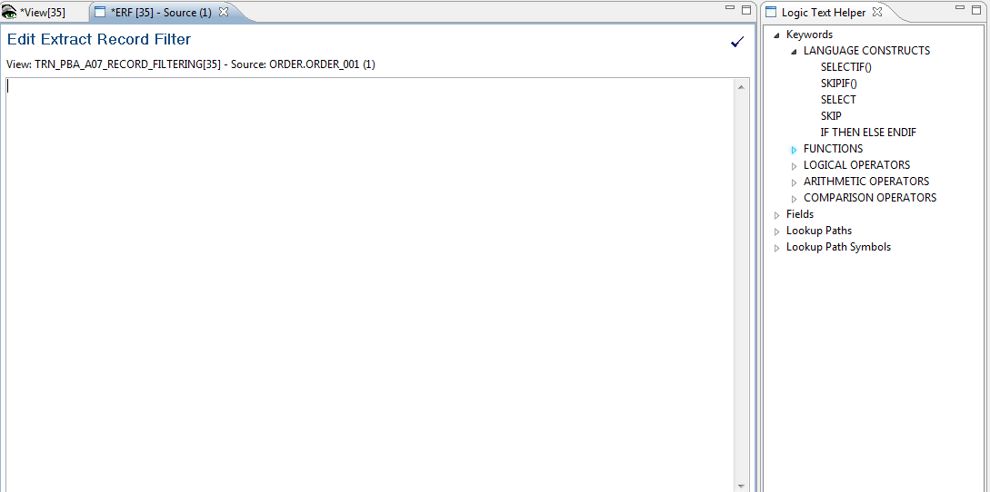
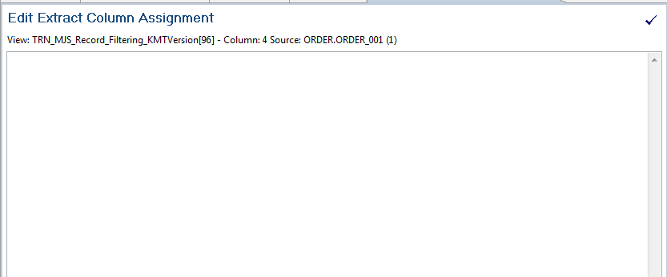
Record Filter versus Column Assignments
Record filtering either includes or excludes entire rows of data.
Field 1 Customer Name | Field 2 Customer Type | Field 3 Order Date
ABC Corp | Commercial | Jan 2000
Dan and Sally J | Retail | March 2006
State of Georgia | Government | April 2005
Fred and Katy H | Retail | Dec 1990
IF ({ORDER_DATE}>"20000101") THEN
SELECT
ELSE
SKIP
ENDIF
Column formulas populate output records columns.
Column 1 Count of All Customers | Column 2 Count of Retail Customers | Column 3 Count of Commercial Customers | Column 4 Other Types of Customers
1 |  | 1
1 | 1
1
IF ({CUSTOMER_TYPE}=“RETAIL") THEN
COLUMN = 1
ELSE
COLUMN = 0
ENDIF
Notes:
In contrast to record filtering, GenevaERS provides column assignment logic and column calculations, which also use GenevaERS logic text. Column logic is used to populate output columns with field values, constants, or calculations.
In the top example, record filtering excluded all customers with orders prior to January 2000. In the bottom example, columns are populated based upon customer type, either retail or commercial. Note that no value is assigned for the third record because this record refers to a government customer.

Slide 4
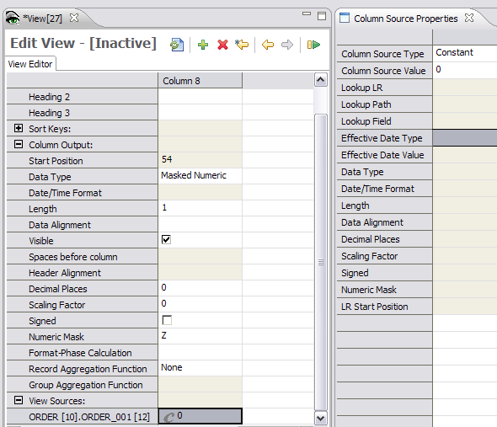
Column Formulas – Simple Column
Notes:
© Copyright IBM Corp. 2012, licensed under Apache 2.0 to the GenevaERS project .
Remember that a constant can be applied to a column by clicking in the View Source cell and then selecting the Column Source Type constant in the Column Source Properties pane.

Slide 5
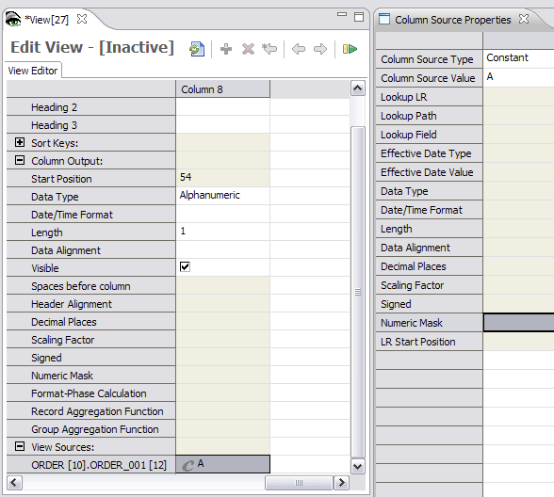
Column Formulas – Constant Alphanumeric
Notes:
© Copyright IBM Corp. 2012, licensed under Apache 2.0 to the GenevaERS project .
An alphanumeric value is entered “as is.” It is not included in single or double quotation marks. If spaces are assigned to the column, they will not be visible in this cell. Later you’ll see a better way of assigning a space to a column.

Slide 6
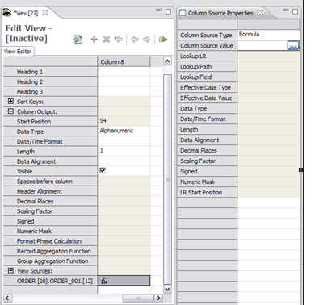

Column Formulas – Column Source Type “Formula”
Select Formula.
Double-click anywhere in the cell to display the icon. Then click the icon that is displayed.
Notes:
© Copyright IBM Corp. 2012, licensed under Apache 2.0 to the GenevaERS project .
An alternative approach to assigning values to a column is to use a column formula. To enter a formula, select Formula in the Column Source Type field. Then double-click anywhere in the Column Source Value cell to display the icon, and click the icon.

Slide 7
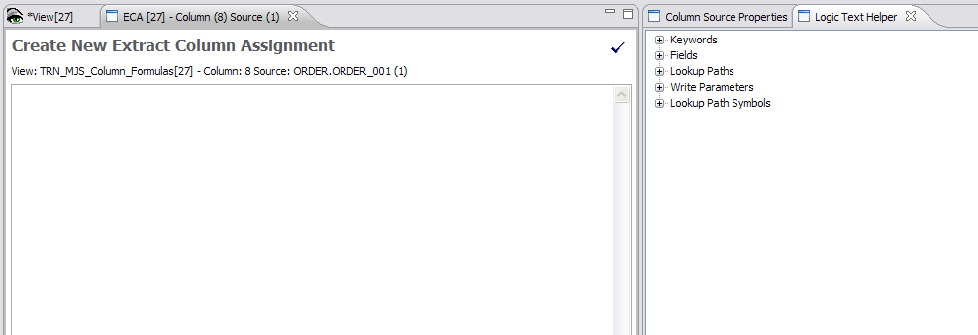
Column Formulas – Logic Text Editor
Check completed syntax with this icon.
Pull valid values from here.
Place logic text here.
Notes:
© Copyright IBM Corp. 2012, licensed under Apache 2.0 to the GenevaERS project .
The Logic Text Editor includes the Logic Text Helper, which enables you to place keywords, field names, and column numbers into logic for column assignment. These functions are similar to functions provided by record filtering.

Slide 8
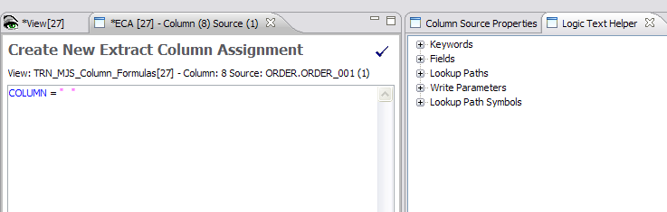
Column Formulas – COLUMN =
Double quotes are used to assign an alphanumeric value.
Notes:
© Copyright IBM Corp. 2012, licensed under Apache 2.0 to the GenevaERS project .
A very simple “column equals” statement can be used to assign a constant value to a column. In this example, a constant value of a space is assigned to a column. Constants surrounded with double quotation marks create alphanumeric constants.

Slide 9
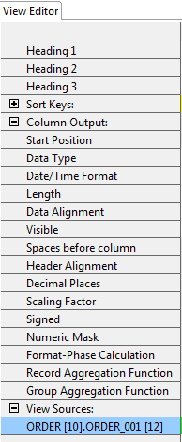
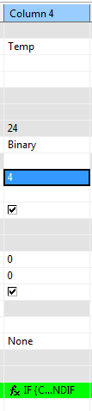
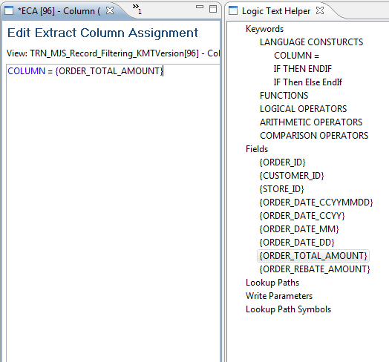
Column Formulas and Column Attributes
The ORDER_TOTAL_AMOUNT will be written as a 4-byte binary field.
Notes:
© Copyright IBM Corp. 2012, licensed under Apache 2.0 to the GenevaERS project .
Field values and constants assigned in logic text must fit within the column output attributes that will be used to define the output. In this example, the value of ORDER_TOTAL_AMOUNT is written as a 4-byte binary field in the output file.

Slide 10
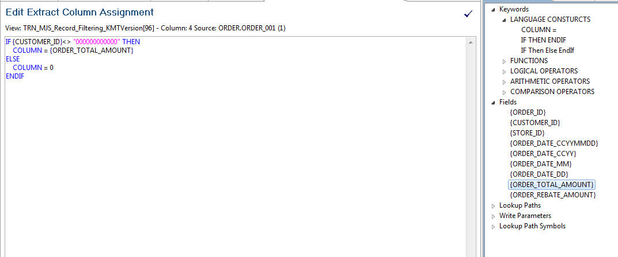
Column Formulas – IF THEN ELSE
The result will be either the ORDER_TOTAL_AMOUNT or 0.
Notes:
© Copyright IBM Corp. 2012, licensed under Apache 2.0 to the GenevaERS project .
Column logic can include if-then-else logic as well. The column output will contain the result of the THEN or the ELSE conditions. Nested IFs are also permitted.
In this example, the value of ORDER_TOTAL_AMOUNT or the constant of 0 is written to the output file.

Slide 11
Alternative IF THEN ELSE Constructs
IF ({CUSTOMER_ID}>“00000000") THEN
COLUMN = ORDER_TOTAL_AMOUNT
ELSE
COLUMN = 0
ENDIF
COLUMN = 0
IF ({CUSTOMER_ID}>“00000000") THEN
COLUMN = ORDER_TOTAL_AMOUNT
ENDIF
The item below is NOT a recommended construct. Results are unpredictable.
IF ({CUSTOMER_ID}>“00000000") THEN
COLUMN = ORDER_TOTAL_AMOUNT
ENDIF
Notes:
© Copyright IBM Corp. 2012, licensed under Apache 2.0 to the GenevaERS project .
If then else logic can be written several ways. In addition to the typical IF THEN ELSE, a value can be assigned to a column and then a test can be performed to see whether that value should be overwritten.
All three logic statements seem to result in the same output. However, the third statement, without an implicit ELSE condition, is not recommended and may have unpredictable results. The second statement is also less efficient because the assignment is overwritten when the IF condition is true.

Slide 12
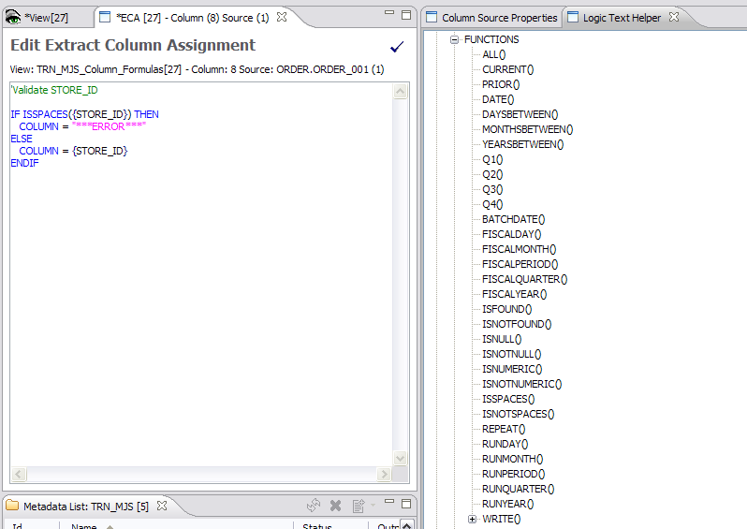
Column Formulas – Function
Notes:
© Copyright IBM Corp. 2012, licensed under Apache 2.0 to the GenevaERS project .
In addition to using field names in logic text, you can use functions. This column uses the ISSPACES function, which tests a field value equal to spaces. If true, the output column contains the text “***Error***”; if not true, it contains the store ID.

Slide 13
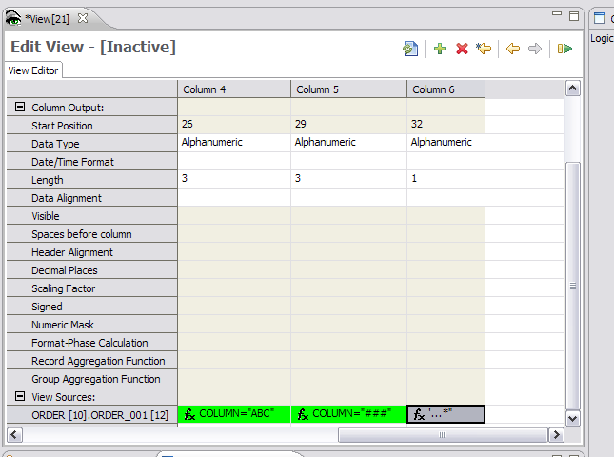
Column Formulas – Column Value Reassignment
Column 6 can assign
values to columns 4 and 5.
Notes:
© Copyright IBM Corp. 2012, licensed under Apache 2.0 to the GenevaERS project .
Column logic can be used to assign values to a prior column, which is called reassignment. Column logic is applied to columns starting from the left and moving to the right. Thus columns are populated left to right within GenevaERS, and previously assigned values can be overwritten by later columns.

Slide 14
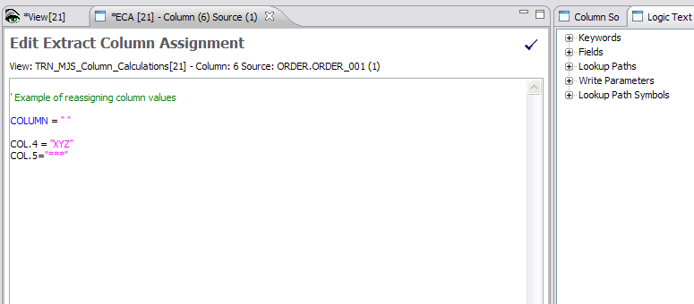
Column Formulas – Column Value Reassignment
Values are reassigned to columns 4 and 5.
Value is assigned to column 6.
Notes:
© Copyright IBM Corp. 2012, licensed under Apache 2.0 to the GenevaERS project .
Within the logic text, COLUMN= assigns a value to the current column, and COL.nn= refers to a prior column, where nn is the column number. Because columns are populated left to right, only prior columns can be referenced within column formulas. This feature does not require the same logic to be repeated in multiple columns; all columns depending upon the logic statement can be assigned within one column.
In this example, the logic within column 6 assigns, first, a space to column 6, second, the value XYZ to column 4, and third, asterisks to column 5.

Slide 15
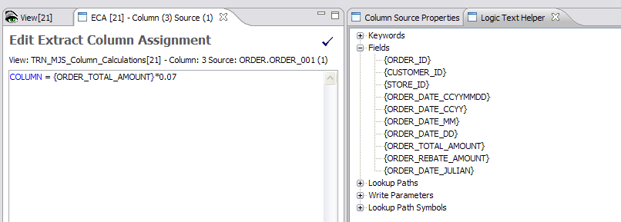
Column Formulas – Field Calculations
Notes:
IBM Security AppScan Source V8.6 Fundamentals
© Copyright IBM Corp. 2012, licensed under Apache 2.0 to the GenevaERS project .
Column logic allows calculations to be performed against numeric fields. Any calculation referencing a field name is performed at extract time because the Extract phase has visibility into all fields on the input LR.

Slide 16
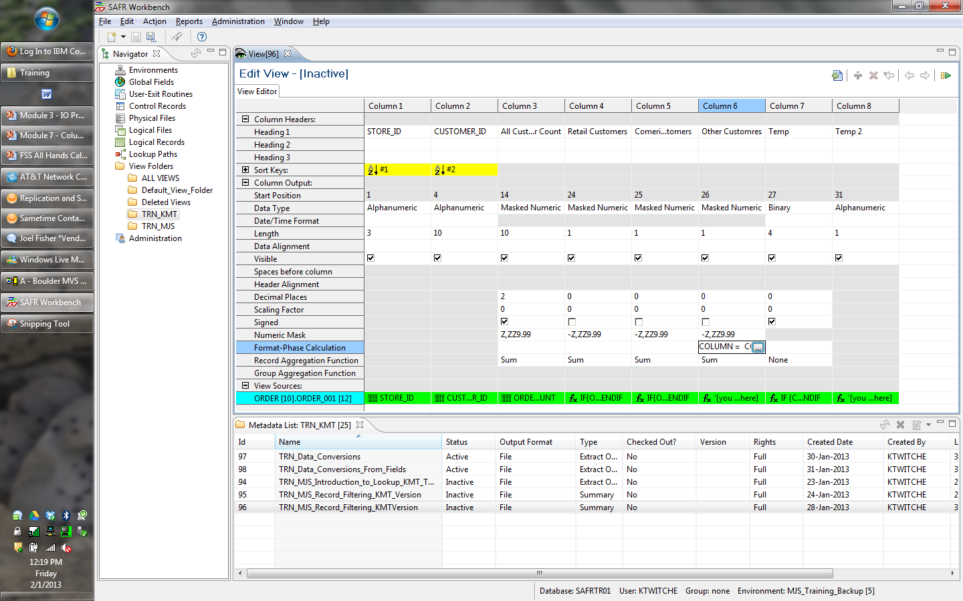
Column Formulas – Format Phase Calculations (1 of 2)
Format phase calculation is accessed here.
Notes:
IBM Security AppScan Source V8.6 Fundamentals
© Copyright IBM Corp. 2012, licensed under Apache 2.0 to the GenevaERS project .
Format phase column formulas are accessed by double-clicking anywhere in the Format-Phase Calculation cell to display the icon, and then clicking the icon.

Slide 17
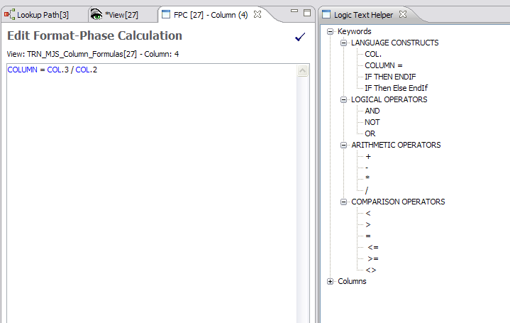
Column Formulas – Format Phase Calculations (2 of 2)
Notes:
IBM Security AppScan Source V8.6 Fundamentals
© Copyright IBM Corp. 2012, licensed under Apache 2.0 to the GenevaERS project .
Format calculations can be performed only on records that have made it through record selection, via the Extract phase. Format phase calculations refer to columns rather than field numbers. The only columns available for calculations are columns that are numeric, perform aggregation, or are the results of calculations.
In this example, column 4 is populated with the results of column 3 divided by column 2.

Slide 18
Record Filter versus Column Assignments (1 of 3)
Record Functions
Column Functions
IF ({ORDER_DATE}>"20000101") THEN
SELECT
ELSE
SKIP
ENDIF
IF ({CUSTOMER_TYPE}=“RETAIL") THEN
COLUMN = 1
ELSE
COLUMN = 0
ENDIF
Extract Phase
Edit Format-Phase Record Filter
Edit Format-Phase Calculation
SKIPIF(COL.4>0)
COLUMN = COL.1 - COL.2 - COL.3
Format Phase
Notes:
The following slides show the interaction of all four types of record and column filtering in the order they are applied by the Performance Engine.
The order is:
Extract phase record filtering
Extract phase column filtering and assignment
Format phase column calculations, and
Format phase output record filtering

Slide 19
Record Filter versus Column Assignments (2 of 3)
Record filtering either includes or excludes entire rows of data.
Field 1 Customer Name | Field 2 Customer Type | Field 3 Order Date
ABC Corp | Commercial | Jan 2000
Dan and Sally J | Retail | March 2006
State of Georgia | Government | April 2005
Fred and Katy H | Retail | Dec 1990
IF ({ORDER_DATE}>"20000101") THEN
SELECT
ELSE
SKIP
ENDIF
Notes:
The Extract phase performs input record filtering, determining which records should be selected for processing. In this example, record number 4 is not selected for further processing because its date is less than January 2000.
These examples of selected records are used on the next slide to illustrate column assignment.

Slide 20
Record Filter versus Column Assignments (3 of 3)
Selected Records
Field 1 Customer Name | Field 2 Customer Type | Field 3 Order Date
ABC Corp | Commercial | Jan 2000
Dan and Sally J | Retail | March 2006
State of Georgia | Government | April 2005
IF ({CUSTOMER_TYPE}=“RETAIL") THEN
COLUMN = 1
ELSE
COLUMN = 0
ENDIF
Column 1 Count of All Customers | Column 2 Count of Retail Customers | Column 3 Count of Commercial Customers | Column 4 Other Types of Customers
1 | 0 | 1
1 | 1 | 0
1 | 0 | 0
COLUMN = 1
IF ({CUSTOMER_TYPE}=“COMMERCIAL") THEN
COLUMN = 1
ELSE
COLUMN = 0
ENDIF
Notes:
Column assignment is performed on each record that passes record level filtering. It assigns specific values to the columns.
In this example, a zero is assigned to columns where the true condition failed on the first and third rows. The third column assigns similar logic based upon commercial customers, whereas the first column is assigned a 1 on every row.
These examples of extracted columns are used on the next slide to illustrate column calculations.

Slide 21
Format Phase Column Calculations
Edit Format-Phase Calculation
COLUMN = COL.1 - COL.2 - COL.3
Format phase calculation assigns a value to the last column.
Column 1 Count of All Customers | Column 2 Count of Retail Customers | Column 3 Count of Commercial Customers | Column 4 Other Types of Customers
1 | 0 | 1 | 0
1 | 1 | 0 | 0
1 | 0 | 0 | 1
Notes:
The Format phase performs column calculations using column values assigned in the Extract process, and then performs record filtering, based upon the final records.
In this example, column 4 is added to the output in the Format phase, based upon the column calculation. Because column 4 subtracts the value in either column 2 or column 3, it ends up being a count of non-retail, non-commercial customers.
These examples of calculated columns are used on the next slide to illustrate Format phase output filtering.

Slide 22
Format Phase Output Record Filters
Column 1 Count of All Customers | Column 2 Count of Retail Customers | Column 3 Count of Commercial Customers | Column 4 Other Types of Customers
1 | 0 | 0 | 1
Edit Format-Phase Record Filter
Format phase filtering produces this final output.
SKIPIF(COL.4>0)
Column 1 Count of All Customers | Column 2 Count of Retail Customers | Column 3 Count of Commercial Customers | Column 4 Other Types of Customers
1 | 0 | 1 | 0
1 | 1 | 0 | 0
1 | 0 | 0 | 1
Notes:
The Format phase performs record filtering as the last step before writing to the output file. It works against aggregated records if the view summarizes records. Otherwise it works against detailed records, as in this example.
In this example, the filter tests column 4 selects only non-zero records.
In conclusion, because of the combination of record filtering, column assignment, column calculation logic, and this final output record filter, the output file ends up being an extract of all non-retail, non-commercial customers.

